Slide 1
System Modeling & Design
Implementation of a Mobile Based Disaster Management System
Design
Course: Internet and Mobile Programming
Course Instructor: Dr. NKEMENI VALERY
Group 7

Slide 2
System Modeling & Design
The process of creating models to visualize, specify, construct, and document the structure and behavior of a software system.
To provide a visual representation of the system, making it easier for stakeholders to understand complex structures and processes.
Definition and Purpose

Slide 3
What we will cover
Context Diagram
Use Case Diagram
Sequence Diagram
Class Diagram
Deployment Diagram

Slide 4
Context Diagram
high-level, simplified view of the system and its interactions with external entities.

Slide 5
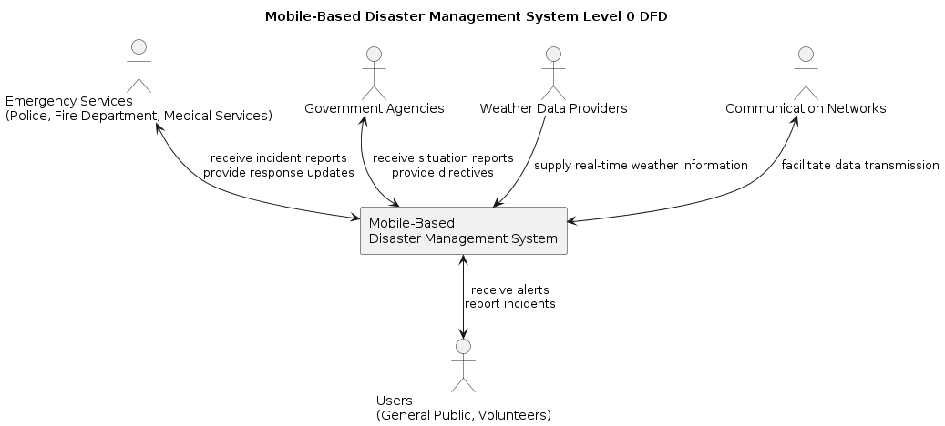
System
Mobile-Based Disaster Management System
Entities
Users (General Public, Volunteers)
Emergency Services (Police, Fire Department, Medical Services)
Government Agencies
Weather Data Providers
Communication Networks
Interactions
Users report incidents and receive alerts.
Emergency services receive incident reports and provide response updates.

Slide 6
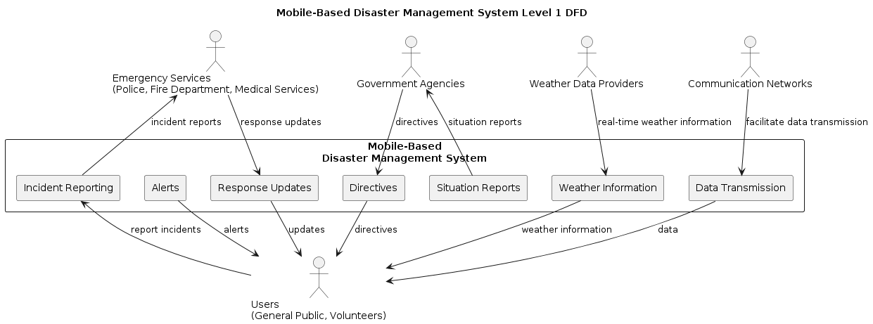

Slide 7
Use Case Diagram
It shows the interactions between users (actors) and the system to achieve specific goals

Slide 8
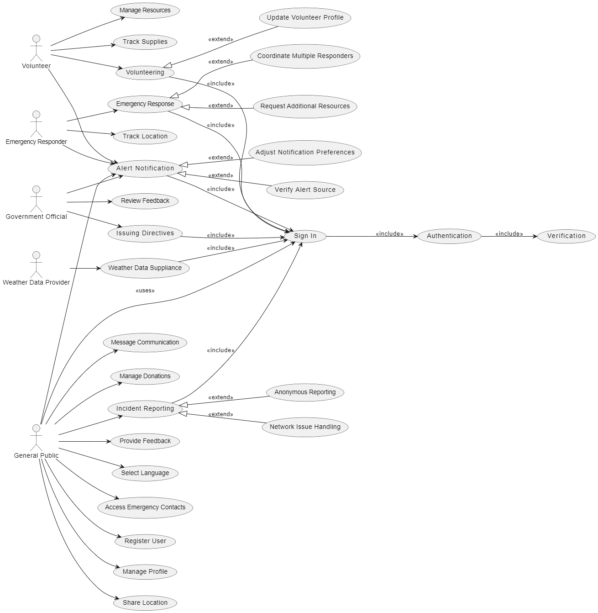
StakeHolders
Public
Volunteer Emergency Responder
Government officials
Weather Data Provider
Use Cases associated to volunteers
Manage Resources
Track Supplies
Volunteering
Government Official
Issuing directives
Review feedback
Use Cases associated to Emergency Responders
Emergency Response
Location Tracking
Volunteering
Use Cases associated to the public
Message
Manage Donations
Incident Reporting
Provide Feedback
Select Language
Access Emergency Contacts
Register User
Manage Profile
Share Location
Others
Authentication
Verification
Alert verification
etc

Slide 9
Class Diagram
Describes the static structure of a system.

Slide 10
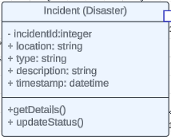
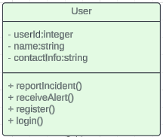
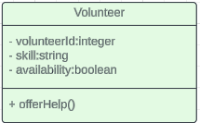
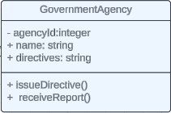
Aggregation relationship
Reports
Aggregation relationship
Assists
Aggregation relationship
Oversees

Slide 11
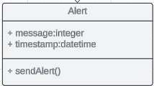
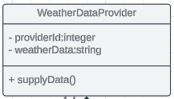
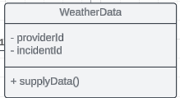
Aggregation relationship
Generates
Aggregation relationship
provides
Association relationship

Slide 12
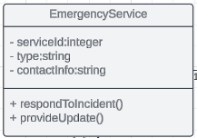
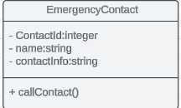
Aggregation relationship
Manages
Composition relationship Composed of
Association relationship

Slide 13
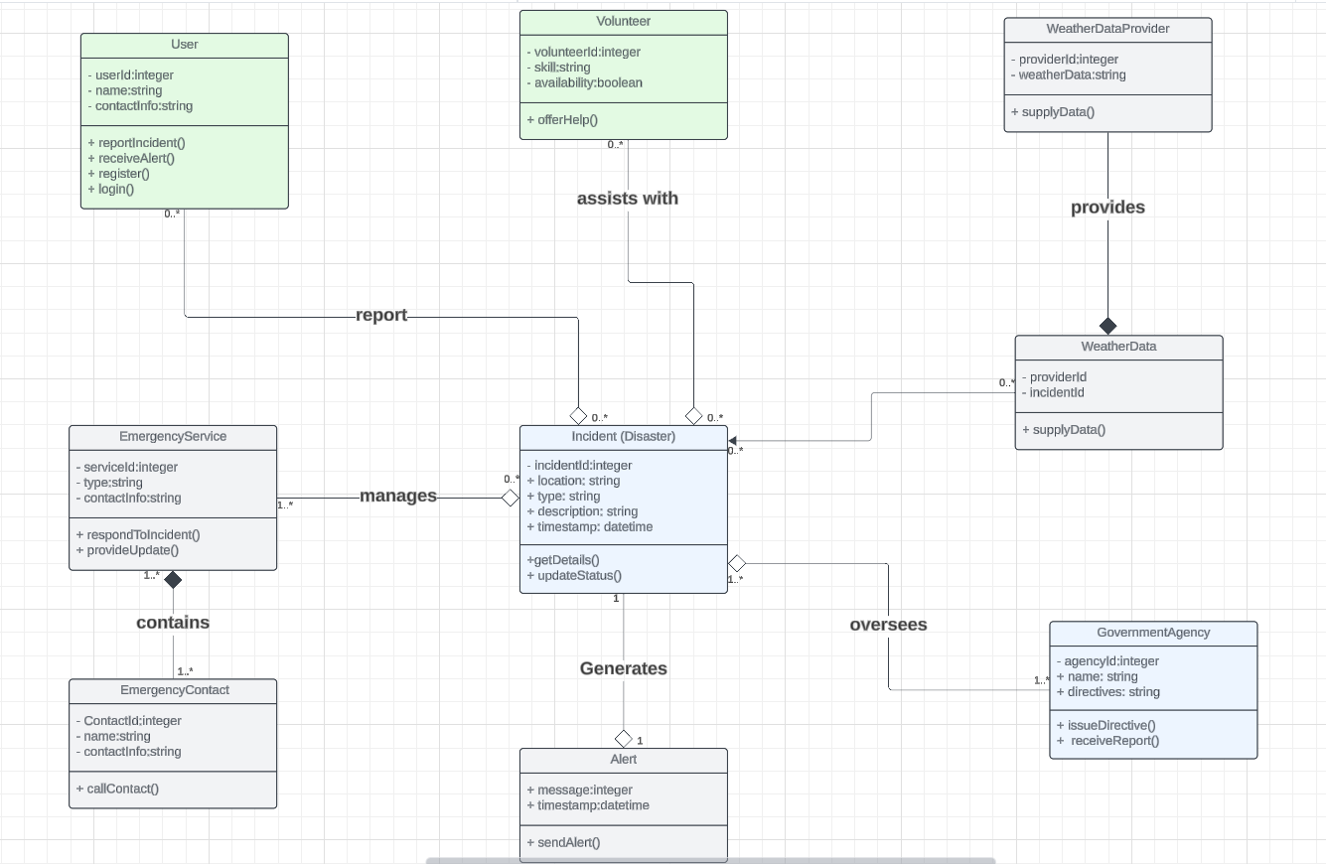

Slide 14
Sequence Diagram
A sequence diagram details the interactions between objects in a specific sequence of time

Slide 15
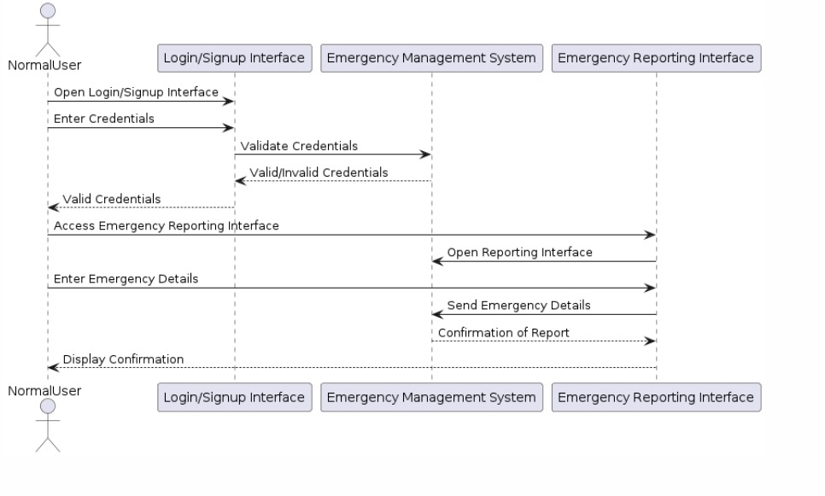

Slide 16
Deployment Diagram
Illustrates the physical arrangement of hardware and software in the system.

Slide 17
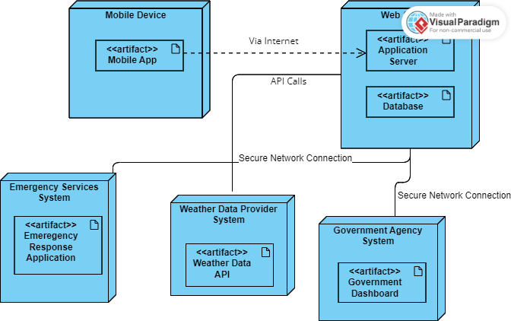

Slide 18
Conclusion
System modeling and design is the cornerstone for building resilient, effective software solutions.

